Slide 1
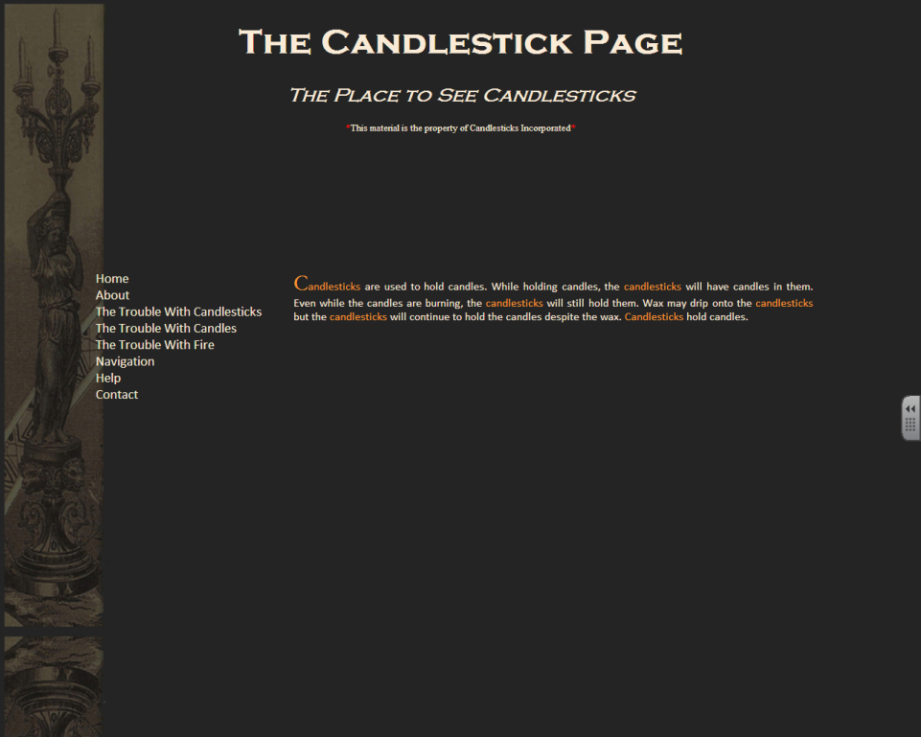
CSS
The Box Model

Slide 2
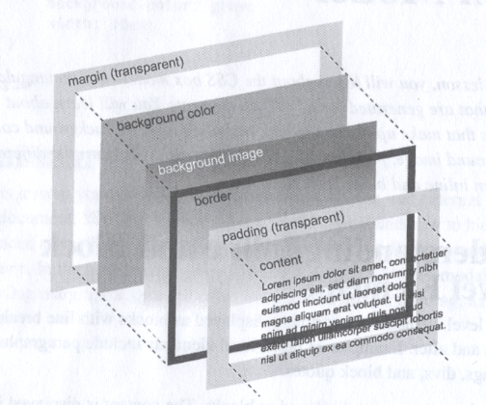
The Box Model
HTML elements are laid out on screen in a layered model called the Box Model. Each graphical piece added to the element has its place in the model.
As indicated by the diagram, the content of the element is the focal point. It is surrounded by padding, border, and margin, all adjustable with CSS. Behind it you find the background image and the background color, also adjustable with CSS.

Slide 3
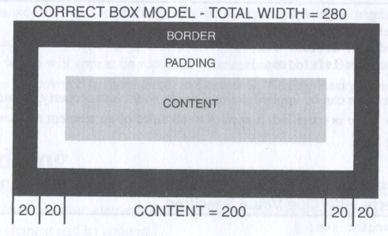
Width
The width of an element is more than just the width of the content. When you set the width using CSS, you must keep in mind the fact that both the border and the padding take up space.
Some older versions of Internet Explorer do not take the padding and the border into account when calculating width. This is incorrect.

Slide 4
Padding
Padding is great way to space out your elements so that clients can more easily view your content. As you can see from the diagram, padding will push your borders away from the content.
Padding is defined using a measurement. In addition to the padding shorthand CSS property, the four sides are also available (padding-left, padding-top, padding-right, padding-bottom).
When you set a measurement for padding (and/or border), that measurement is fixed. Changing the width of your element, will adjust the width of the content so that it and the padding (and/or border) will fit the specified measurement.

Slide 5
Position
With an understanding of the box model, you can begin to position your elements in ways so they won’t look awkward at certain resolutions and they won’t get in the way of other elements.
The position CSS property has 4 values, none of which actually place the element anywhere. Instead, they define how the element will be placed on screen and whether or not that placement can be manipulated by other CSS properties.
When you set the position property to something other than static, you change alter its position with left, top, right, and bottom. These properties require measurement values. Top and left are the most commonly used. Right and bottom are usually set by the size of the element.

Slide 6
Static
Static is the default positioning for all elements. An element with static positioning is placed on screen in the next available space as determined by its position in the code.
This is a lot less confusing than it sounds. It’s exactly what you’ve been seeing all along.
Certain CSS properties, like margin, have to take the positioning of an element into account.
An understanding of the static position is essential in order to build an understanding of the other positioning elements.

Slide 7
Relative
Relative positioning means that you can adjust the position of the element using left, top, right, and bottom. These values, however, are not specific to places on the screen. Instead, they place an element relative to where it would be if its positioning were static.
<style>
div {position:relative; top:100px;}
</style>
In this case, the top of the div would be placed 100 pixels from its static position, which is just under the header.
<h1>Header</h1>
<div>Text</div>

Slide 8
Fixed
Fixed positioning allows you to set a left, top, right, and/or bottom position for the element based on the window. This is very different from relative wherein the measurement values provided are exact positions on the screen.
<style>
div {position:fixed; top:100px;}
</style>
In this case, the top of the div would be placed at the exact vertical position of 100 pixels on screen. Without the left being set, it would use its static left position.
Be aware that giving an element a fixed positioning removes it from its static context. Other elements cannot use it as a point of reference and therefore may overlap.

Slide 9
Absolute
Absolute positioning allows you to set a left, top, right, and/or bottom position for the element based on the first ancestor that does have static positioning. This differs from fixed in that the browser will check the parent elements of an absolute element. If there are no parent elements without static positioning, the absolute element will be positioned based on the screen as if it were fixed.
<style>
div {position:relative;}
span {position:absolute; top:100px;}
</style>
<div>
<span>Text</span>
</div>
The span will be given an exact position based on the size and position of the parent div.

